Slide 1
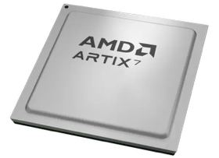
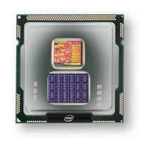
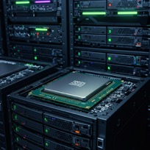
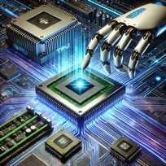
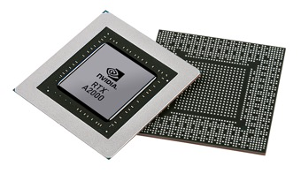


Christof Teuscher
ECE 410/510: Hardware for AI and ML
GPUs + CUDA
Portland State University
Department of Electrical and Computer Engineering (ECE)
www.teuscher-lab.com
teuscher@pdx.edu

Slide 2
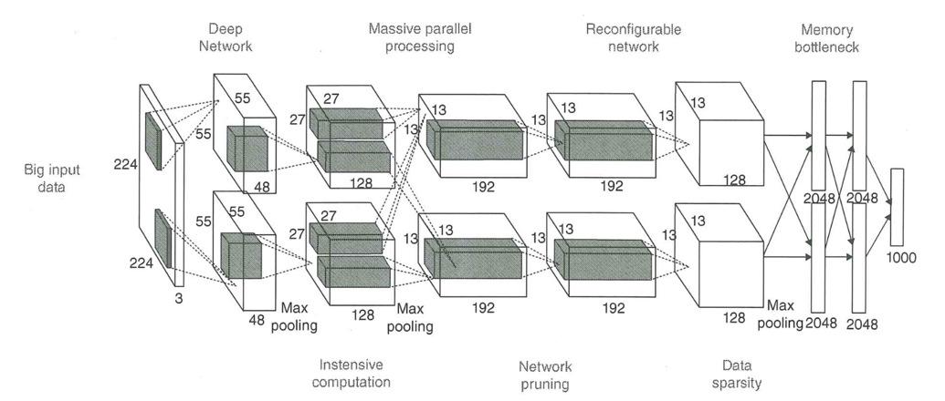
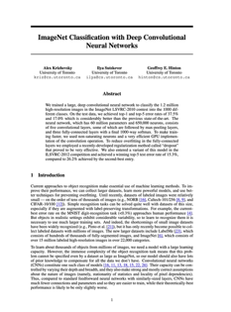
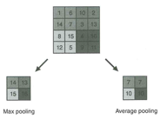
AlexNet: A classical deep convolutional neural network
AlexNet paper: https://papers.nips.cc/paper_files/paper/2012/file/c399862d3b9d6b76c8436e924a68c45b-Paper.pdf
Liu & Law, Artificial Intelligence Hardware Design, 2021

Slide 3
Flexibility vs perfomance
Why is running a neural network simulation on a general purpose processor inefficient?
How can we improve performance?
What is a better processor architecture?

Slide 4
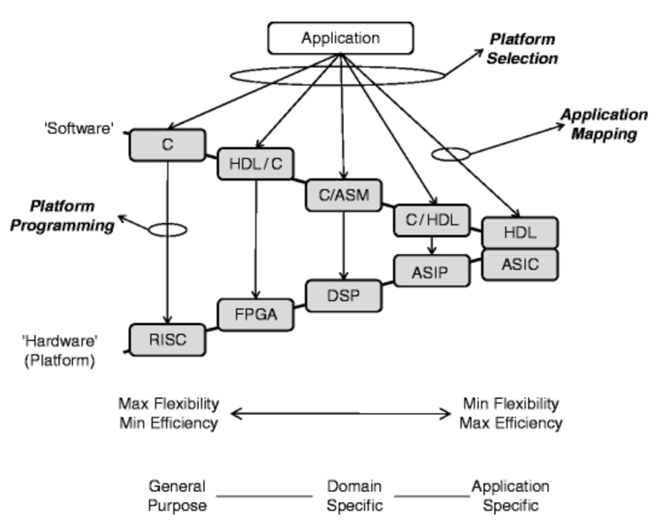
The HW/SW co-design space
ASIP = Application Specific Instruction Processor
Schaumont, 2013

Slide 5
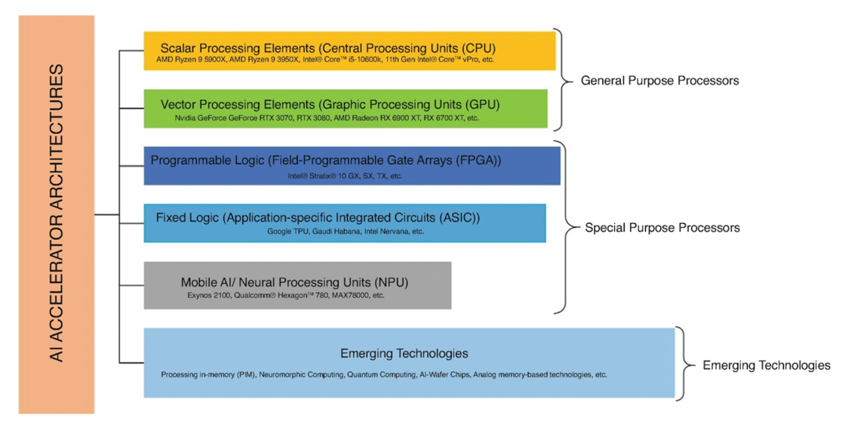
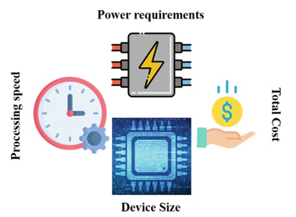
Hardware for AI/ML
Metrics
Mishra et al., 2023

Slide 6
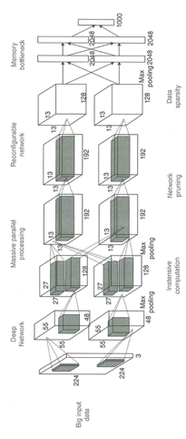
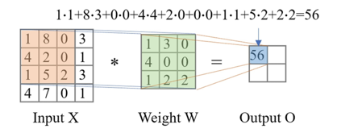
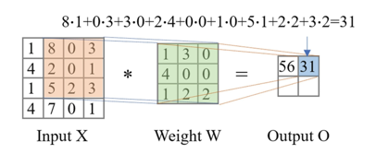
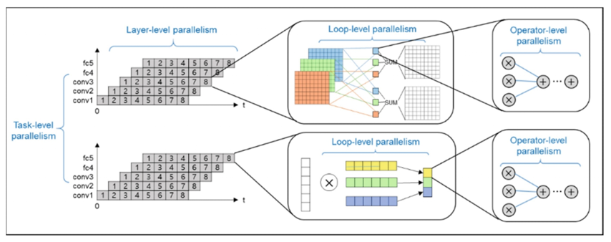
Exploiting parallelism

Slide 7

Paper discussion
What did you learn?

Slide 8
Paper discussion (1)
The difference between these papers shows how the field of co-design has evolved from general principles to specialized approaches for complex AI systems over nearly three decades.
LLMs face unique challenges compared to traditional deep learning systems, requiring extensive computational resources, high energy consumption, and complex software optimizations.
LLMs differ from CNNs in their memory requirements and processing patterns, requiring unique co-design methodologies.

Slide 9
Paper discussion (2)
Co-design is about a systems perspective: meeting system-level objectives.
Co-design is the key to designing efficient systems.
Designing HW is increasingly like designing SW.
Flexibility vs performance trade-off.
E.g., reconfigurability increases usability, but does not increase performance.
Co-design tools: modeling, validation, implementation.
Identify critical segments of SW and run them on special HW.
LLMs require unique optimization strategies.
GPT-3: 175 billion parameters, 350GB of GPU memory just for parameters
GPUs are the cornerstone of modern deep learning infrastructure.

Slide 10
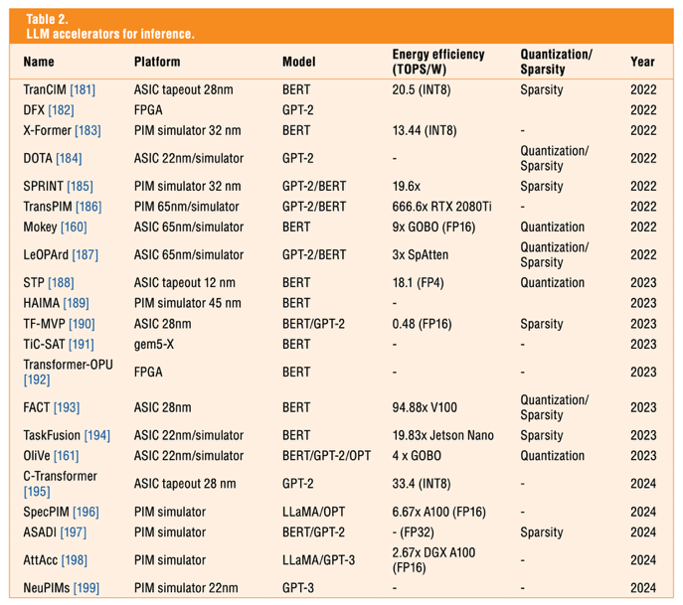
Paper discussion (3)
Guo et al., 2025

Slide 11
Hardware for AI/ML

Slide 12
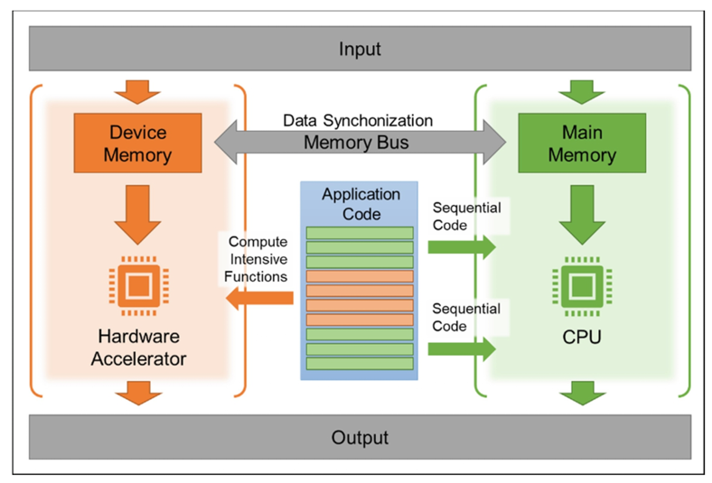
General co-processing mechanism
Mishra, Ashutosh; Cha, Jaekwang; Park, Hyunbin; Kim, Shiho. Artificial Intelligence and Hardware Accelerators, 2025

Slide 13
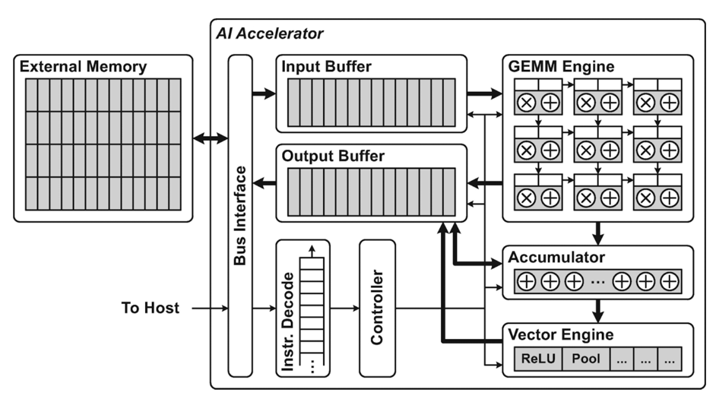
General AI accelerator architecture
GEMM = General Matrix Multiply
Tensor cores!
A vector is a 1st-order tensor
A matrix is a 2nd-order tensor.
Mishra, Ashutosh; Cha, Jaekwang; Park, Hyunbin; Kim, Shiho. Artificial Intelligence and Hardware Accelerators, 2025

Slide 14
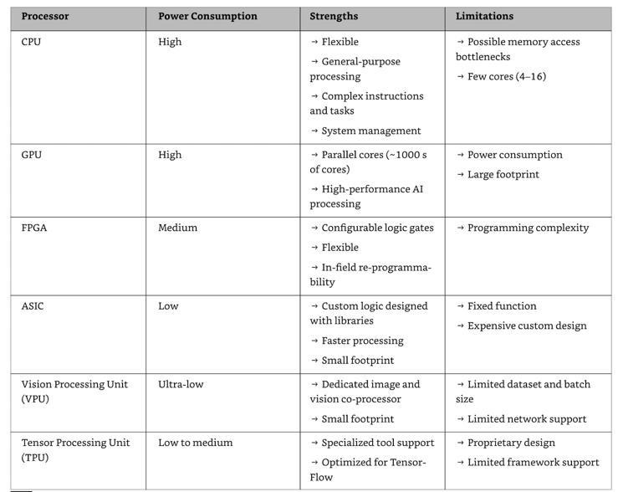
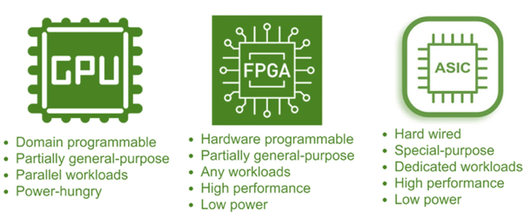
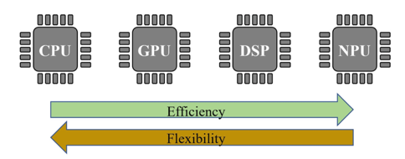
Hardware for AI/ML
Mishra et al., 2023

Slide 15
Hardware for AI/ML
Mishra et al., 2023

Slide 16
Graphics Processing Units (GPUs)

Slide 17

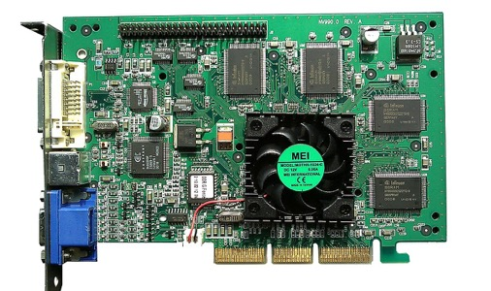
A bit of history
Over several decades, GPUs evolved from a single core, fixed function
hardware used for graphics solely, to a set of programmable parallel cores.
The history of modern GPUs starts in 1995 with the introduction of the first 3D add-in cards.
1996: 3DFx’s Voodoo graphics card took over about 85% of the market. Cards that could only render 2D became obsolete very fast.
1999: NVIDIA’s GeForce 256, the “world’s first GPU.”

Slide 18

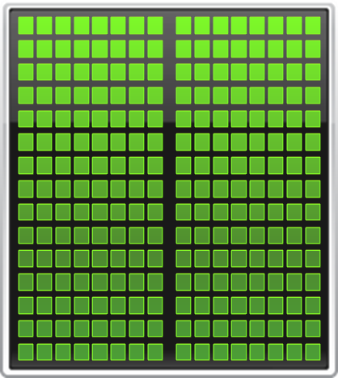

Multi-core vs GPU
CPU
GPU
NVIDIA
Notes:
GPU Computing is a type of heterogeneous computing – that is, parallel computing with multiple processor architectures. In GPU computing,
Many-core GPUs are combined with multicore CPUs to achieve higher performance.
Today’s CPUs have 4, 6, 8 or even 12 cores, while GPUs have up to 512 cores in a single chip.
Today’s computing applications typically have data intensive regions with a large amount of inherent parallelism. GPUs accelerate these parallel
Regions by spreading the computation over hundreds of cores. This can deliver significant acceleration for many applications.

Slide 19
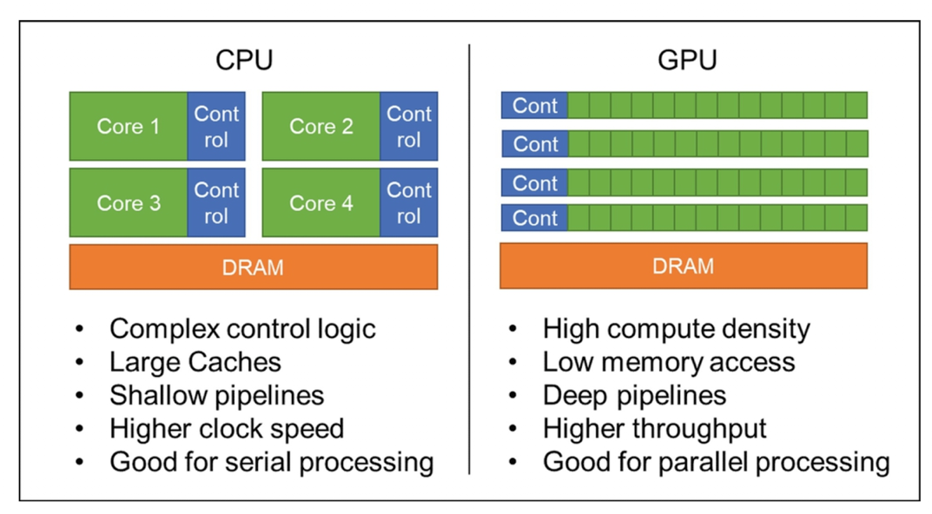
Multi-core vs GPU
SIMT (Single Instruction, Multiple Threads) is a parallel processing model used in GPUs where multiple threads execute the same instruction simultaneously, but on different data.
Mishra, Ashutosh; Cha, Jaekwang; Park, Hyunbin; Kim, Shiho. Artificial Intelligence and Hardware Accelerators, 2025

Slide 20
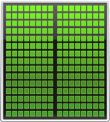

Small Changes, Big Speed-up
Application Code
Rest of Sequential
CPU Code
GPU
Compute-Intensive Functions
CPU
Use GPU to Parallelize
NVIDIA
Notes:
Your time is precious, which is why performance is critical. So you need to focus on what’s important.
To add GPU acceleration, simply identify and accelerate the *performance-critical areas* in your application.
The rest can run as-is on the CPU. There’s no need for an entire application to be ported to the GPU.
The key point here is that in a hybrid architecture where GPUs and CPUs are working together, developers only need to accelerate performance-critical functions on the GPUs in the system.

Slide 21
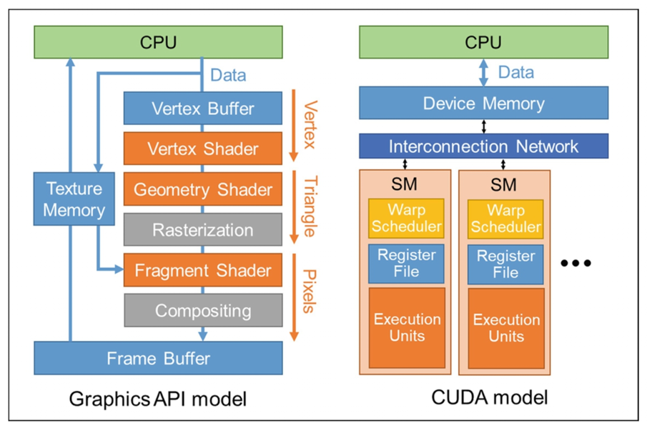
CUDA model
General-purpose computing on GPU (GPGPU)
Early GPGPU was implemented by formulating data and operations in graphics primitives and translated to pass through a fixed graphics pipeline.
Mishra, Ashutosh; Cha, Jaekwang; Park, Hyunbin; Kim, Shiho. Artificial Intelligence and Hardware Accelerators, 2025

Slide 22
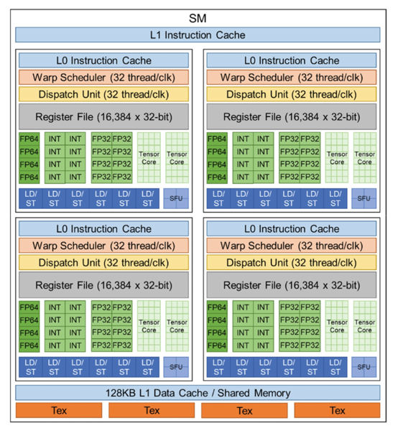
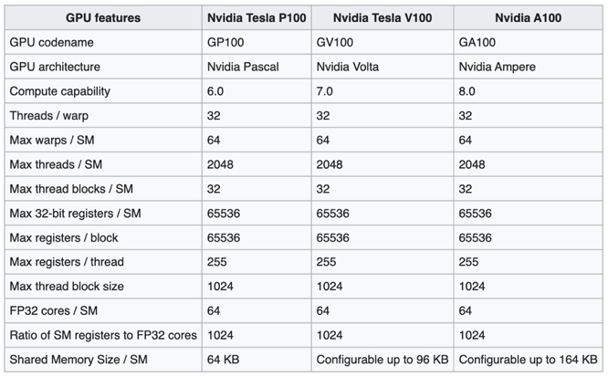
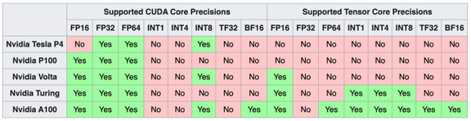
NVIDIA Volta Microarchitecture (2013-2017)
Streaming multiprocessor
Processing block
First chip to feature tensor cores
A GV100 SM is partitioned into four processing blocks
Tex = Texture units
SFU = Special Function Unit

Slide 23
Warp
A "warp" is a group of threads that execute instructions simultaneously on a GPU (Graphics Processing Unit).
The warp scheduler is a component of the GPU architecture that manages the execution of these thread groups.
A warp typically consists of 32 threads in NVIDIA GPUs (AMD calls similar groupings "wavefronts"). These threads execute the same instruction at the same time in a SIMT (Single Instruction, Multiple Thread) architecture.
The warp scheduler is responsible for:
Deciding which warps are ready to execute
Allocating compute resources to warps
Managing warp context switching when threads need to wait for memory operations.
Hiding memory latency by switching between warps

Slide 24
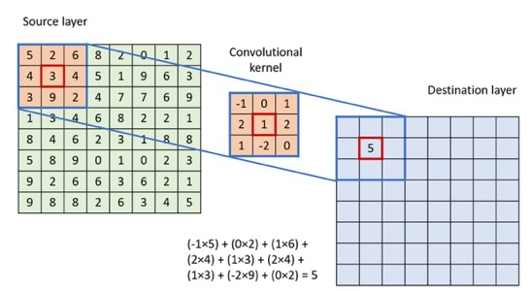
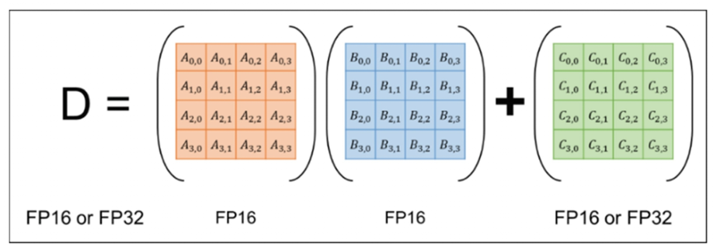
Tensor cores
Each tensor core executes MMA (matrix multiplication and accumulation, D = A × B + C) on a 4 × 4 floating-point matrix.
They are built to enhance deep learning by boosting matrix arithmetic.
Low-precision operations often supported.
Convolution
MMA
Mishra et al., 2023

Slide 25
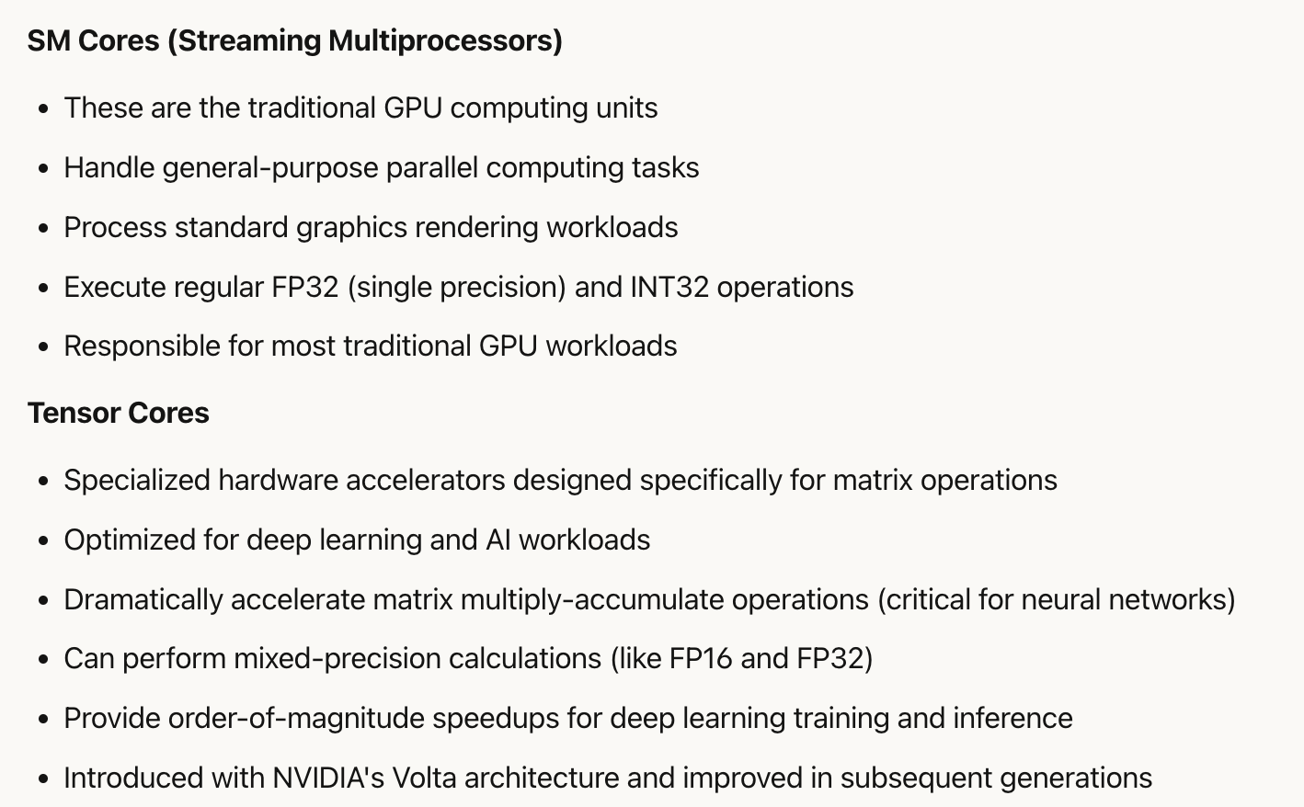
Streaming vs tensor cores

Slide 26
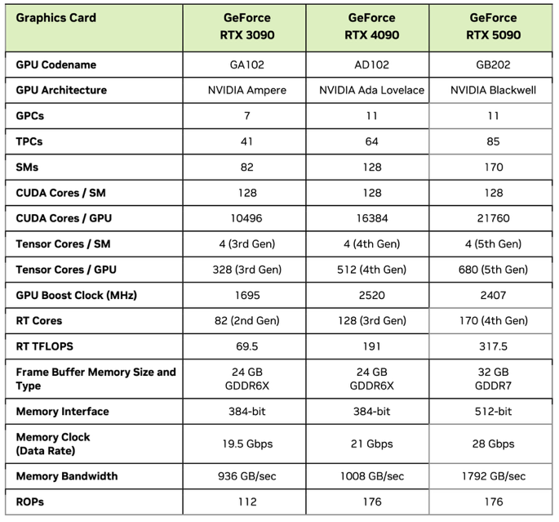
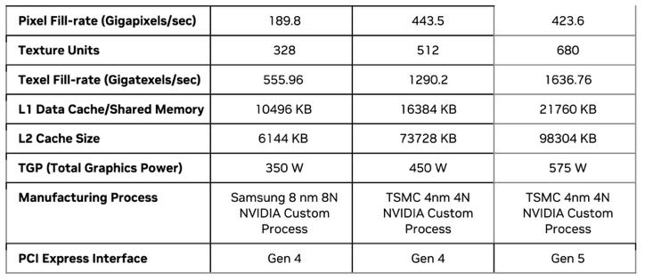
Consumer-grade GPUs
x
=
GPC: Graphics Processing Clusters
TPC: Texture Processing Cluster
SM: Streaming Multiprocessor
RT: Ray Tracing
ROP: Render Output Unit

Slide 27
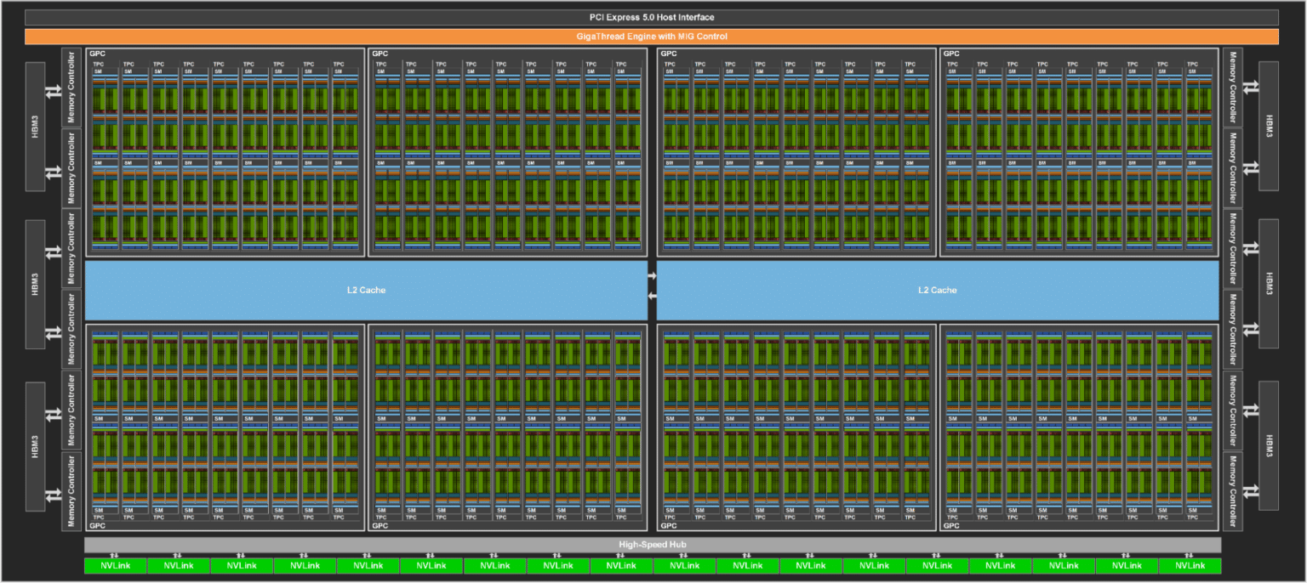
RTX 5090
GPC: Graphics Processing Clusters
TPC: Texture Processing Cluster
SM: Streaming Multiprocessor

Slide 28
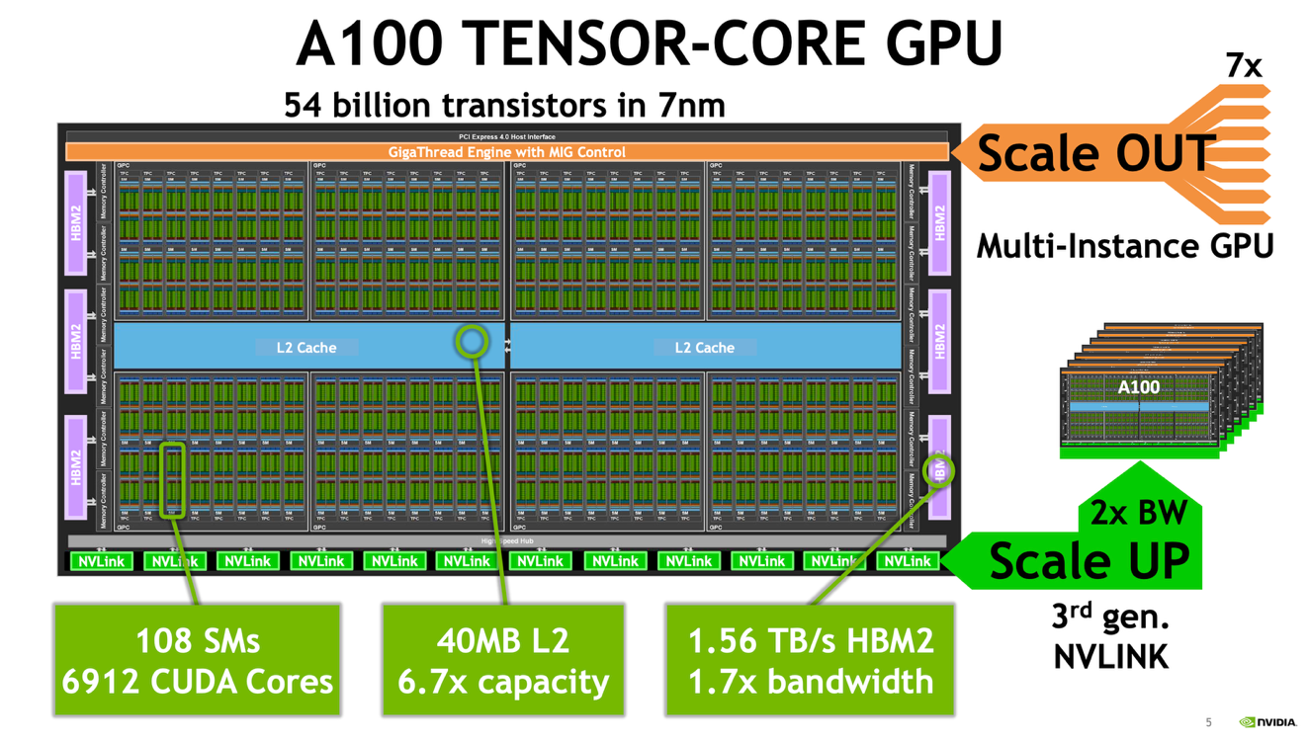

Slide 29
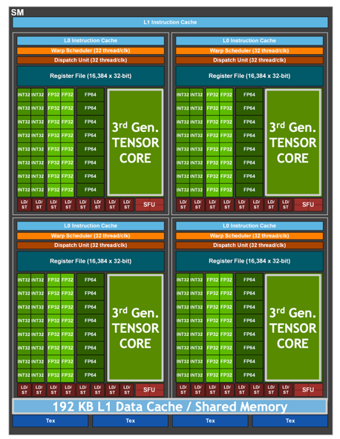
V100
A100

Slide 30
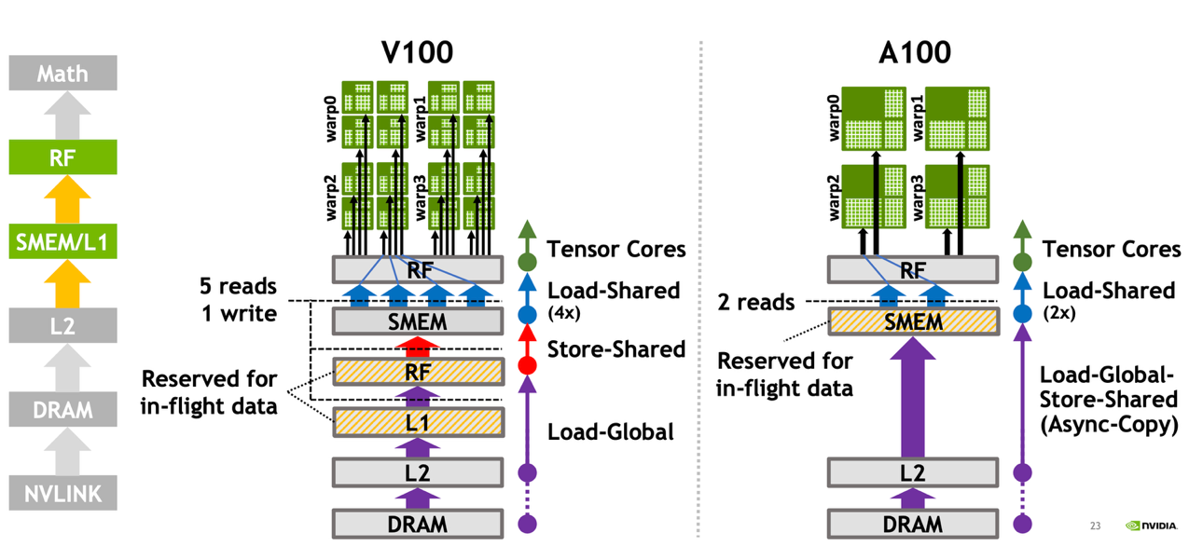
A100 data movement efficiency
3x SMEM/L1 bandwidth, 2x in-flight capacity
Register file
Share memory
in-flight data = data that is actively being processed or transferred within the system but hasn't yet reached its final destination

Slide 31
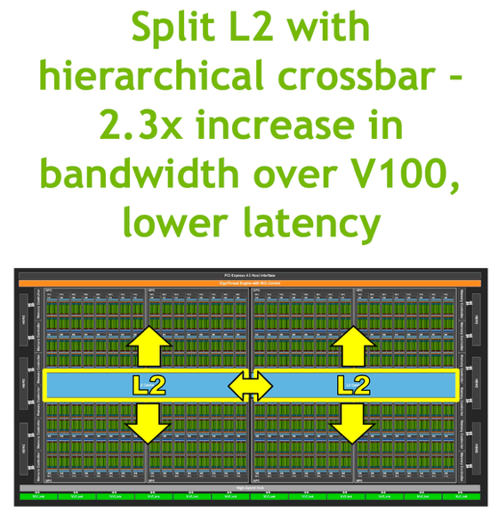
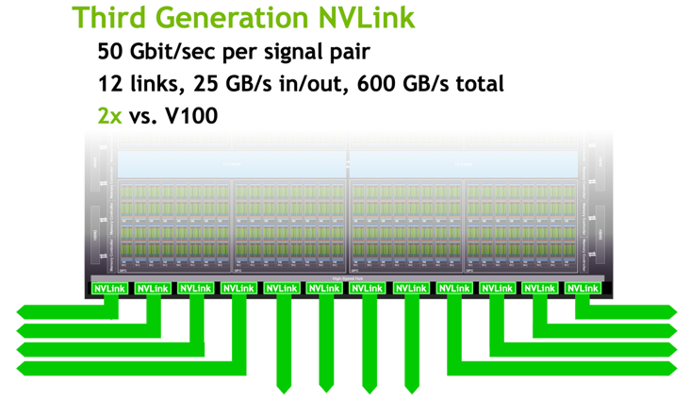
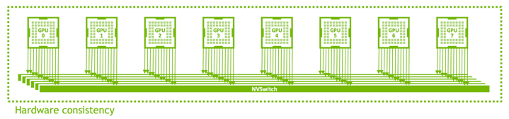
A100 data movement efficiency

Slide 32
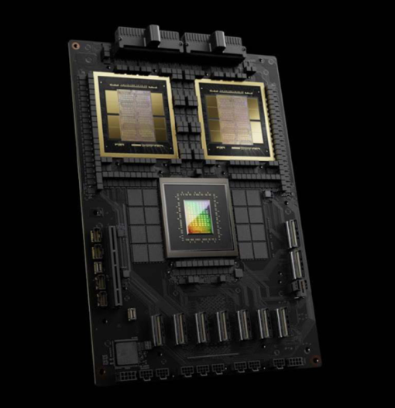
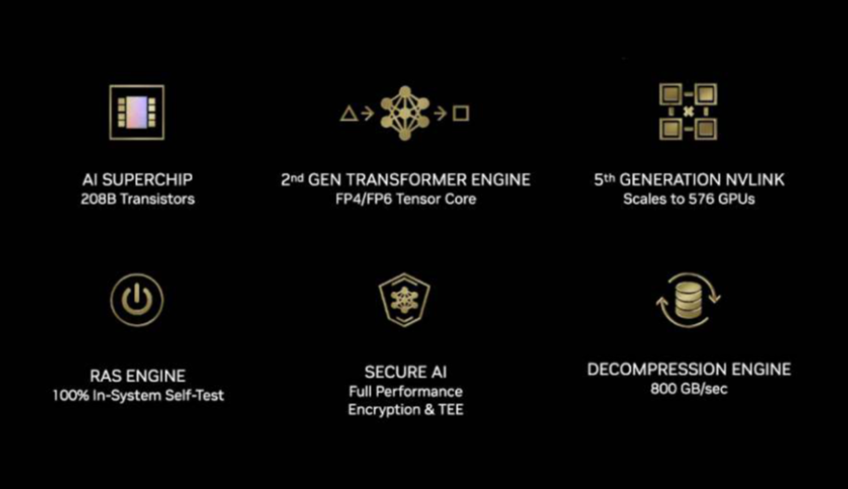
GB100 $40k, GB200: $70k
RAS (Reliability, Availability, and Serviceability)

Slide 33
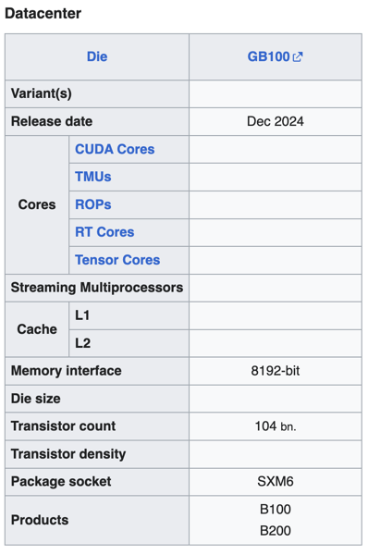
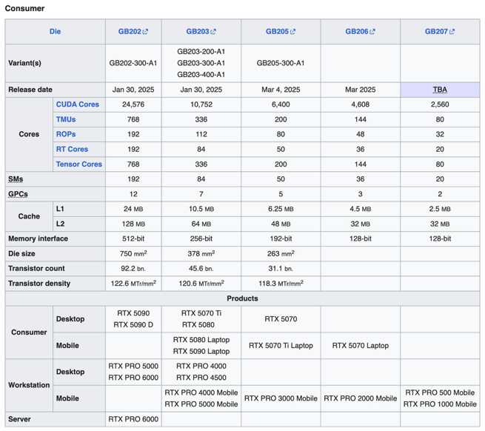

Slide 34

CUDA
CUDA (Compute Unified Device Architecture) is a parallel computing platform and programming model developed by NVIDIA.
It enables developers to use NVIDIA graphics processing units (GPUs) for general-purpose computing, a practice known as GPGPU (General-Purpose computing on Graphics Processing Units).
Good resource: https://docs.nvidia.com/cuda/cuda-c-programming-guide

Slide 35
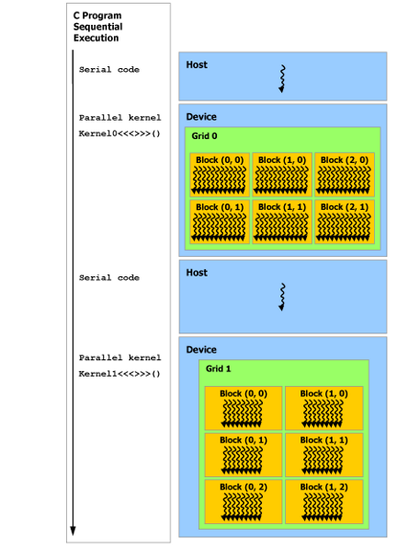

Programming and execution model
A GPU is built around an array of Streaming Multiprocessors (SMs). A multithreaded program is partitioned into blocks of threads that execute independently from each other, so that a GPU with more multiprocessors will automatically execute the program in less time than a GPU with fewer multiprocessors.
CUDA programming model assumes that the CUDA threads execute on a physically separate device that operates as a coprocessor to the host running the C++ program.
Serial code executes on the host while parallel code executes on the device.

Slide 36
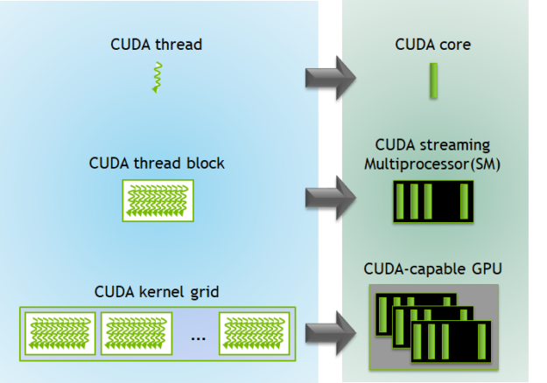
Programming and execution model
A GPU is built around an array of Streaming Multiprocessors (SMs). A multithreaded program is partitioned into blocks of threads that execute independently from each other, so that a GPU with more multiprocessors will automatically execute the program in less time than a GPU with fewer multiprocessors.

Slide 37
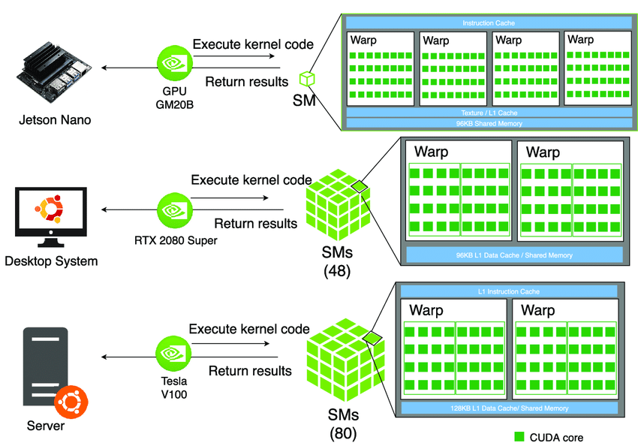
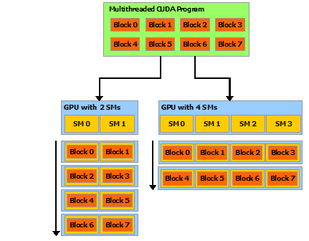
Automatic scalability
A GPU is built around an array of Streaming Multiprocessors (SMs). A multithreaded program is partitioned into blocks of threads that execute independently from each other, so that a GPU with more multiprocessors will automatically execute the program in less time than a GPU with fewer multiprocessors.

Slide 38
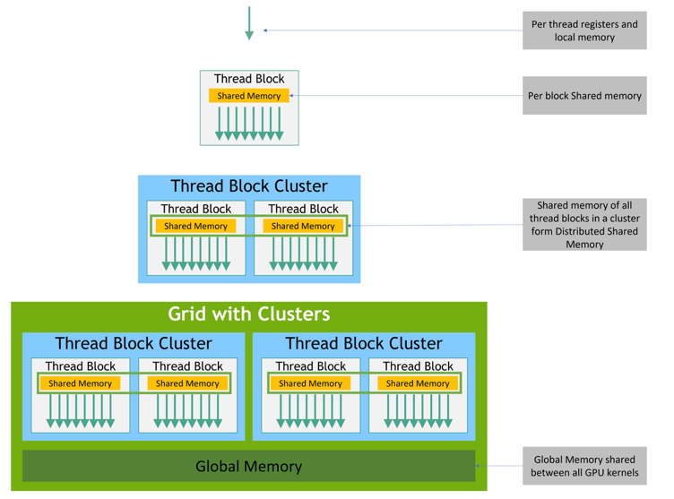
Memory hierarchy
CUDA threads may access data from multiple memory spaces during their execution.
Each thread has private local memory.
Each thread block has shared memory visible to all threads of the block and with the same lifetime as the block.
Thread blocks in a thread block cluster can perform read, write, and atomics operations on each other’s shared memory.
All threads have access to the same global memory.

Slide 39

Kernels (1)
CUDA C++ extends C++ by allowing the programmer to define C++ functions, called kernels, that, when called, are executed N times in parallel by N different CUDA threads, as opposed to only once like regular C++ functions.
A kernel is defined using the __global__ declaration specifier and the number of CUDA threads that execute that kernel for a given kernel call is specified using a new <<<...>>> execution configuration syntax.
Each thread that executes the kernel is given a unique thread ID that is accessible within the kernel through built-in variables.

Slide 40


Kernels (2)
As an illustration, the following sample code, using the built-in variable threadIdx, adds two vectors A and B of size N and stores the result into vector C.
Single Instruction, Multiple Threads (SIMT)

